Slide 1
Capability Maturity Model Advanced Software Engineering

Slide 2
What is CMM?
A method for assessing software processes
A benchmark to measure the maturity of an organization’s software development process
Helps organizations develop, improve, and refine their software processes
Notes:
CMM is a framework used to check how good a company’s software process is and to help make it better.
e. g. teacher needs to choose a team of students to build a big project
Capability Evaluation (Choosing a contractor)
The teacher checks how different teams usually work:
Team A plans their work, follows rules, checks mistakes, and submits on time.
Team B works randomly and only rushes at the last minute.
The teacher predicts that Team A will perform better if given the project. So, the teacher selects Team A.
Software Process Assessment (Self-improvement)
Now imagine Team B wants to improve. They review how they work and realize:
They don’t plan properly
They don’t check their work
So, they decide to make schedules, divide tasks, and review mistakes next time.

Slide 3
CMM
Developed to assess and improve software development processes
Helps organizations progress from chaotic → predictable → optimized
CMM Focus Areas:
Process standardization
Process measurement
Process improvement
Analogy: Learning to cook:
Level 1: Randomly following recipes
Level 5: Perfecting techniques and experimenting efficiently

Slide 4
Overview of the Capability Maturity Model (CMM)
The Capability Maturity Model (CMM)is a development model created after a study of data collected from organizations that contracted with the U.S. Department of Defense, who funded the research.
Developed by the Software Engineering Institute of the Carnegie Mellon University.
Framework that describes the key elements of an effective software process.
Helped organizations to improve the quality of the software.
Adoption of SEI CMM has significant business benefits.

Slide 5
SEI CMM (Software Engineering Institute – Capability Maturity Model)
SEI CMM can be used in two ways:
Capability evaluation
Software Process Assessment
Capability Evaluation This is used to check how capable an organization’s software process is. It helps predict how well a contractor is likely to perform if given a project, so it can be used to choose the right contractor.
Software Process Assessment This is used by an organization to review its own software processes and find ways to improve them.
Notes:
Likely performance is the predicted future performance of a contractor based on the maturity and capability of their processes.
Likely performance refers to how the contractor is expected to perform in terms of:
Meeting deadlines (schedule performance)
Staying within budget (cost performance)
Producing quality work (fewer defects)
Handling risks and changes
Consistency and predictability

Slide 6
Purpose of the Capability Maturity Model (CMM)
Describes an evolutionary improvement path for software organizations from an ad hoc, immature process to a mature, disciplined one.
Provides guidance on how to gain control of processes for developing and maintaining software and how to evolve toward a culture of software engineering and management excellence.

Slide 7
Process Maturity Concepts
Software Process
The set of activities, methods, and practices used to develop and maintain software, along with related artifacts like plans, designs, code, tests, and user manuals.
Software Process Capability
describes the range of expected results that can be achieved by following a software process
means of predicting the most likely outcomes to be expected from the future software project the organization undertakes

Slide 8
Process Maturity Concepts
Software Process Performance
actual results achieved by following a software process
Software Process Maturity
extent to which a specific process is explicitly defined, managed, measured, controlled and effective
implies potential growth in capability
indicates richness of process and consistency with which it is applied in projects throughout the organization

Slide 9
What are the CMM Levels?
The five levels of software process maturity.
Maturity level indicates level of process capability:
Initial
Repeatable
Defined
Managed
Optimizing

Slide 10
Level 1: Initial (AKA Chaotic)
Software development organization at this level is characterized by ad hoc activities.
Very few or no processes are defined and followed.
Since, processes are not defined, engineers follow their own processes and as a result, development efforts become chaotic(disordered or messy).
The success of project depends on individual efforts.
When engineers leave, the successor have great difficulty in understanding the process followed and the work completed.
Since, formal project management practices are not followed, under time pressure, short cuts are tried out leading to low quality product.
Products developed are often over budget and schedule
Notes:
Characteristics:
Processes are ad-hoc or chaotic
Success depends on individual effort
High risk of failure
Example: Startup developing apps without proper planning or documentation
Disscussuion:"What problems might users face when software is developed at Level 1?"

Slide 11
Level 2: Repeatable
At this level, basic process management processes are established to track cost, schedule, and functionality.
Realistic project commitments based on results observed on previous projects
Software project standards are defined and faithfully followed
Processes may differ between projects
Process is disciplined
earlier successes can be repeated
Notes:
Characteristics:
Basic project management processes are established
Past experiences are used to repeat successes
Some predictability in outcomes
Example: Company delivers software using checklists and templates learned from previous projects
Discussion: Identify one advantage of repeating processes over ad-hoc methods

Slide 12
Level 3: Defined
The software process for both management and engineering activities is documented, standardized, and integrated into a standard software process for the organization.
All projects use an approved, personalized version of the organization’s standard software process for developing and maintaining software.
Roles, responsibilities, and standards are clearly defined
Notes:
Characteristics:
Processes are documented and standardized across the organization
Roles, responsibilities, and standards are clearly defined
📍 Example: Software team uses a company-wide development methodology (like Agile or Waterfall) with formal templates, coding standards, and peer reviews
💬 Question: "Why is documentation important for development quality?"

Slide 13
Level 4: Managed
At this level, the focus is on software metrics.
Two types of metrics are collected:
Product Metrics measure the characteristics of the product being developed such as its size, reliability, complexity, understandability etc.
Process Metrics reflects the effectiveness of the process being used. such as
average defect correction time,
average number of defects found per hour inspection,
average number of failures detected during testing etc.
Software process and product quality is measured and quantitative quality requirements for the product are met.
Pareto charts and Fishbone diagrams are used to measure the product and process quality.
Notes:
Processes are measured and controlled
Metrics are collected to monitor productivity, quality, and performance
Outcomes are predictable
Example: A company tracks defects per release, development time, and cost, using this data to improve future projects
📊 Activity: Students suggest three metrics that could be used to measure development quality

Slide 14
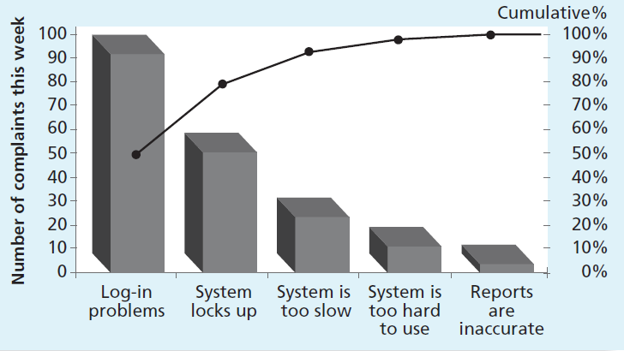
Pareto chart
Pareto chart is a histogram that can help you identify and prioritize problem areas.
Pareto analysis is sometimes referred to as the 80-20 rule, meaning that 80 percent of problems are often due to 20 percent of the causes.
Notes:
A Pareto Chart is a bar graph that shows the frequency or impact of problems in descending order. It helps identify the most significant issues so organizations can prioritize improvement efforts.
Collect data– Categorize---Count/measure---Sort---Cumulative percentage----Draw chart----analyze

Slide 15
Fishbone Diagram
Cause-and-effect diagrams: Trace complaints about quality problems back to the responsible production operations.
In other words, they help you find the root cause of a problem. They are also known as fishbone or Ishikawa diagrams
Notes:
A Fishbone Diagram is a visual tool used to identify root causes of a problem. It looks like a fish skeleton: head = problem, bones = causes.
Head: Problem statement (effect)
Major bones: Categories of causes (often 6 Ms: Man, Machine, Method, Material, Measurement, Mother Nature/Environment)
Minor bones: Sub-causes under each category

Slide 16
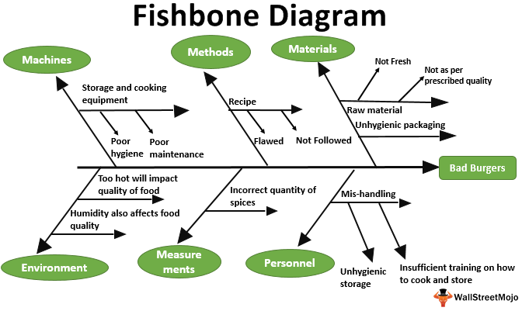
Notes:
Head: Problem statement (effect)
Major bones: Categories of causes (often 6 Ms: Man, Machine, Method, Material, Measurement, Mother Nature/Environment)
Minor bones: Sub-causes under each category

Slide 17
Level 5: Optimizing
Continuous process improvement is enabled by quantitative feedback from the process and from showing innovative ideas and technologies.
Goal is to prevent the occurrence of defects
Data on process effectiveness used for cost benefit analysis of new technologies and proposed process changes
Notes:
Characteristics:
Focus on continuous process improvement
Uses quantitative feedback and best practices to optimize processes
Innovations and automation are applied
Example: Company analyzes trends in defects to implement predictive quality measures and automated testing tools
💡 Reflection Question: "Can Level 5 be achieved by small companies? What challenges might they face?"

Slide 18
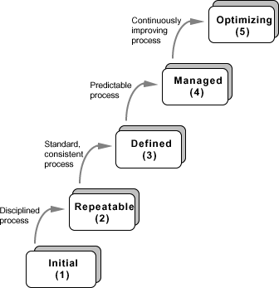
Levels of CMM

Slide 19
Characteristics of CMM
SEI CMM assessment is purely for internal use.
Was developed successfully for software industry and therefore addresses many issues which are specific to software industry.
Goes beyond quality assurance and prepares an organization to ultimately achieve Total Quality Management.
Model provides a list of key process areas on which an organization at any maturity level needs to concentrate to take it from one maturity level to the next.
Provides a way of achieving gradual quality improvement.

Slide 20
Applicability of SEI CMM to organizations
Highly systematic and measured approach to software development suits large organizations dealing with negotiated software, safety-critical software etc.
But small organizations typically handle applications such as Internet, e-commerce, and are without an established product range, revenue base, and experience on past projects, etc.
For such organizations, a CMM-based evaluation is probably unnecessary.
These organizations need to operate more efficiently at the lower levels of maturity.
For example, they need to practice effective project management, reviews, configuration management, etc.

Slide 21
Internal Structure to Maturity Levels
Except for level 1, each level is decomposed into key process areas (KPA)
Each KPA identifies a cluster of related activities that, when performed collectively, achieve a set of goals considered important for enhancing software capability.
commitment
ability
activity
measurement
verification

Slide 22
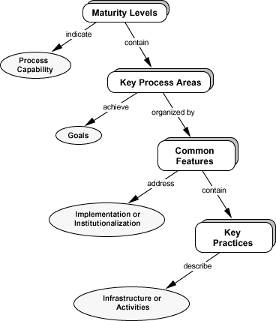

Slide 23
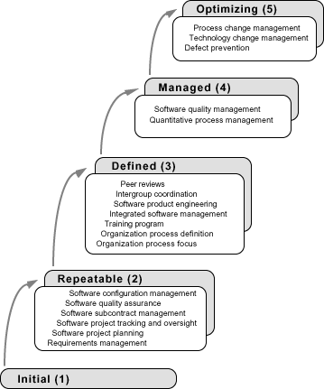

Slide 24
Level 2 KPAs
Requirements Management
Establish common understanding of customer requirements between the customer and the software project
Requirements is basis for planning and managing the software project
Software Project Planning
Establish reasonable plans for performing the software engineering activities and for managing the software project

Slide 25
Level 2 KPAs
Software Project Tracking and Oversight
Establish adequate visibility into actual progress
Take effective actions when project’s performance deviates significantly from planned
Software Subcontract Management
Manage projects outsourced to subcontractors
Software Quality Assurance
Provide management with appropriate visibility into process being used by the software projects work products

Slide 26
Level 3 KPAs
Organization Process Focus
Establish organizational responsibility for software process activities that improve the organization’s overall software process capability
Organization Process Definition
Develop and maintain a usable set of software process assets
stable foundation that can be established
basis for defining meaningful data for quantitative process management

Slide 27
Level 3 KPAs
Training Program
Develop skills and knowledge so that individual can perform their roles effectively and efficiently
Organizational responsibility
Needs identified by project
Integrated Software Management
Integrated engineering and management activities
Engineering and management processes are custom-made from the organizational standard processes
Modifying based on business environment and project needs

Slide 28
Level 3 KPAs
Software Product Engineering
technical activities of the project are well defined (SDLC)
correct, consistent work products
Intergroup Coordination
Software engineering groups participate actively with other groups
Peer Reviews
early defect detection and removal
better understanding of the products
implemented with inspections, walkthroughs, etc

Slide 29
Level 4 KPAs
Quantitative Process Management
control process performance quantitatively
actual results from following a software process
focus on identifying and correcting special causes of variation with respect to a baseline process
Software Quality Management
quantitative understanding of software quality
products
process

Slide 30
Level 5 KPAs
Process Change Management
continuous process improvement to improve quality, increase productivity, decrease cycle time
Technology Change Management
identify and transfer beneficial new technologies
tools
methods
processes
Defect Prevention
causal analysis of defects to prevent recurrence

Slide 31
Why measure software and software process?
Obtain data that helps us to better control
schedule
cost
quality of software products

